Slide 1
YOUR BRAND INFLUENCE Strategies for Building an Influential Personal Brand Monsanto HR Specialist Meeting – Sept. 16, 2013 By: Lethia Owens
Lethia Owens International Inc. :: www.LethiaOwens.com :: (800) 670-0712

Slide 2
Your Current Personal Branding Strategy…

Slide 3
Friday and Monday Video

Slide 4
What if it could look like this?

Slide 5
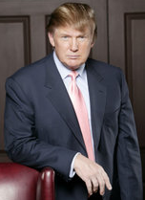
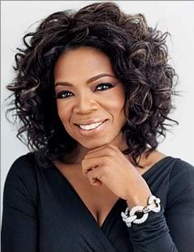
The Power of a Brand
Notes:
Notes:
________________________________________________________________________________
________________________________________________________________________________
________________________________________________________________________________
________________________________________________________________________________
________________________________________________________________________________
________________________________________________________________________________
________________________________________________________________________________
________________________________________________________________________________
________________________________________________________________________________
________________________________________________________________________________
________________________________________________________________________________
________________________________________________________________________________
________________________________________________________________________________
________________________________________________________________________________
________________________________________________________________________________
________________________________________________________________________________
________________________________________________________________________________
________________________________________________________________________________
________________________________________________________________________________

Slide 6
The Basics of Branding
Companies spend lots of $$$ building brands that are…
Noticeable
Memorable
Likable
Credible
Relatable
Dependable

Slide 7
4 Facets of a Influential Personal Brand
If Your Personal Brand Is…
Noticeable
Likable
Credible
Dependable

Slide 8
4 Facets of a Influential Personal Brand
Then It Can
Become Both…
Powerful and Influential!

Slide 9
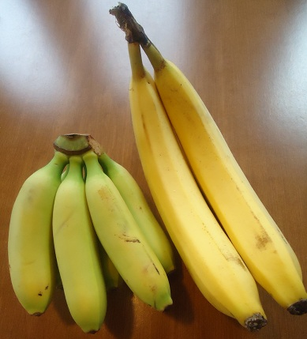
Branding and Positioning is Everything
How are you positioned in the marketplace?

Slide 10
What is Your Personal Brand?
What Words, Phrases, Emotions Do You Own?

Slide 11
It is said that a woman’s
heart rate increases…
when she is holding a Tiffany Blue Box!

Slide 12
Questions To Answer
1) What emotions will your brand touch?
2) What expectations will your brand create?
3) What experiences will your brand provide?
The sum of these questions equals a position in the mind called brand ownership. As your brand ownership increases so does your ability to influence.

Slide 13
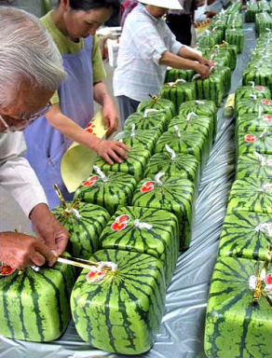
Positioning – Look for Unoccupied Space
What Problem Does Your Brand Solve?

Slide 14
Answer these questions
In ONE word, how would others describe you?
In ONE word, how would you like to be described by others?

Slide 15
I am different
I am unique
I am valuable
I am promotable
I am INFLUENTIAL

Slide 16
Your Powerful Personal Brand
It’s the decisive moments that matter
... every single interaction and
transaction collectively shapes
your personal brand.
Your personal brand is the consensus about who you are…your reputation, public image,
and character.
Your personal brand IS the
collective opinion
about you!

Slide 17
Are You a Stuck Employee?

Slide 18
What makes you unique makes you valuable and what makes you valuable can make you wealthy!

Slide 19
“Success is not being perceived as being the best at what you do…”

Slide 20
“it’s being perceived as being the
ONLY ONE
who does what you do!”
Jerry Garcia of the Grateful Dead

Slide 21
Dubai – Palm Island, The Burg Al Arab and The Burg Khalifa (Tallest Building in the World)

Slide 22
The Deeper You Dig…
The Taller You’ll Stand.

Slide 23
Value
Coffee Beans – Commodity (2 cents)
Cup of Coffee – Diner (50 cents)
Latte – Starbucks (3 dollars)
Espresso – Rome, Italy (15 dollars)

Slide 24
2 Cups for a Total Cost of $30
Notes:
Must Own The Hear Share!

Slide 25
Cost of a Beetle?

Slide 26
Cost of a Bugatti?

Slide 27
Tell Me Why…
Someone would pay
$2.35 million dollars
for a Bugatti when
a Beetle will also
get you from
point A to point B?

Slide 28
You are bigger, more powerful and more valuable than you have ever been
taught to believe.

Slide 29
Notes:
You are Bigger, More Powerful and more Valuable Than You Have Ever Been Taught to Believe.
Collaboration is the Fastest Path to Success.
Become Super Fabulous Girlfriend to Someone and You Both Will Soar.
A phenomenal woman I must be because another woman follows me.

Slide 30
Be Who You Are on Purpose and
without Apology!
Lethia Owens

Slide 31
Service Dog Video

Slide 32
Simple Brand Building Strategies…
Leverage Your Strengths
Manage Your Weaknesses
Notes:
Notes:
________________________________________________________________________________
________________________________________________________________________________
________________________________________________________________________________
________________________________________________________________________________
________________________________________________________________________________
________________________________________________________________________________
________________________________________________________________________________
________________________________________________________________________________
________________________________________________________________________________
________________________________________________________________________________
________________________________________________________________________________
________________________________________________________________________________
________________________________________________________________________________
________________________________________________________________________________
________________________________________________________________________________
________________________________________________________________________________
________________________________________________________________________________
________________________________________________________________________________
________________________________________________________________________________

Slide 33
What do you notice about this slide?
1 x 1 = 1
2 x 2 = 4
3 x 3 = 10
4 x 4 = 16
5 x 5 = 25

Slide 34
What do you notice about this slide?
1 x 1 = 1
2 x 2 = 4
3 x 3 = 9
4 x 4 = 16
5 x 5 = 25
Error in my calculation

Slide 35
We often notice what is wrong first!
1 x 1 = 1
2 x 2 = 4
3 x 3 = 9
4 x 4 = 16
5 x 5 = 25
80% was
Correct

Slide 36
How many times have you seen this world famous logo during your lifetime?
(a) 1-5 (b) 6–20 (c) 21-50 (d) 51-99 (e) Over 100
(This logo is the Registered Trademark of FedEx Corporation)

Slide 37
Have You Ever Noticed This Arrow?

Slide 38
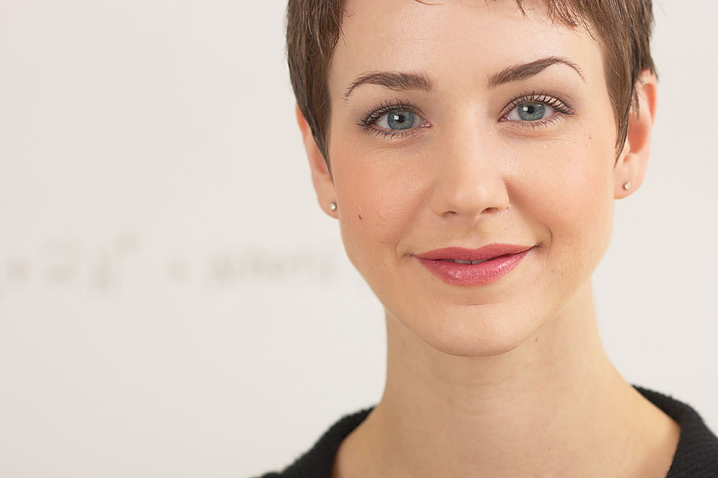
“True discovery consists not in finding new landscapes, but in seeing the same landscape with new eyes.”
Marcel Proust (1871–1922)
French novelist

Slide 39
Simple Brand Building Strategies…
Leverage Your Strengths
Manage Your Weaknesses
Use Feedback as a Power Tool
Notes:
Notes:
________________________________________________________________________________
________________________________________________________________________________
________________________________________________________________________________
________________________________________________________________________________
________________________________________________________________________________
________________________________________________________________________________
________________________________________________________________________________
________________________________________________________________________________
________________________________________________________________________________
________________________________________________________________________________
________________________________________________________________________________
________________________________________________________________________________
________________________________________________________________________________
________________________________________________________________________________
________________________________________________________________________________
________________________________________________________________________________
________________________________________________________________________________
________________________________________________________________________________
________________________________________________________________________________

Slide 40
Feedback is a Gift
When receiving feedback remember to ask yourself, “Is there any truth in what they are saying”?
When giving feedback always remember to focus on…
A SUCCESSFUL future instead of a FAILED past.

Slide 41
Simple Brand Building Strategies…
Leverage Your Strengths
Manage Your Weaknesses
Use Feedback as a Power Tool
Become a Collaborator
Notes:
Notes:
________________________________________________________________________________
________________________________________________________________________________
________________________________________________________________________________
________________________________________________________________________________
________________________________________________________________________________
________________________________________________________________________________
________________________________________________________________________________
________________________________________________________________________________
________________________________________________________________________________
________________________________________________________________________________
________________________________________________________________________________
________________________________________________________________________________
________________________________________________________________________________
________________________________________________________________________________
________________________________________________________________________________
________________________________________________________________________________
________________________________________________________________________________
________________________________________________________________________________
________________________________________________________________________________

Slide 42
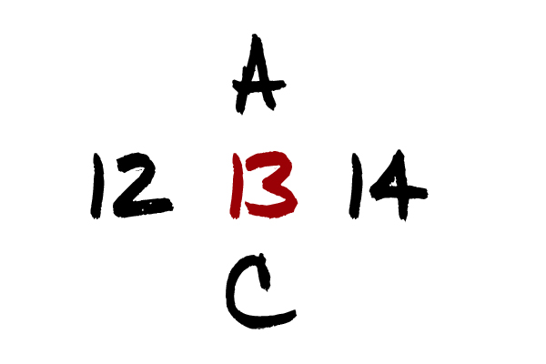

Slide 43
Collaboration is the fastest path to success.

Slide 44
Collaboration is not about being best friends or even liking the people you work with. It is about bringing your best self to the game each and every day by focusing on…
the common goal…TO WIN!

Slide 45
360 Personal Brand Assessment
Free Bonus:
With this Tool You Can Measure the Influence of Your Leadership Brand
www.FreeOffer.LethiaOwens.com

Slide 46
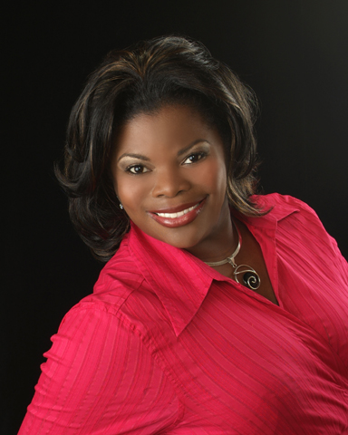
It’s Been My Pleasure Serving You Today!
“May all your heart desires be the least that you receive.”
Let’s Stay Connected:
(636) 294-3902
www.LethiaOwens.Com
Facebook.LethiaOwens.com
Twitter.LethiaOwens.com
LinkedIn.LethiaOwens.com
YouTube.LethiaOwens.com

