Slide 1
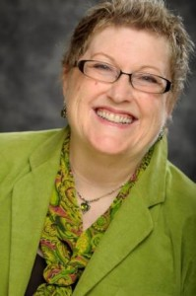
Patty Cook Personal Branding Framework March 10, 2012
Lethia Owens International, Inc. :: www.LethiaOwens.com :: (800) 670-0712

Slide 2
Understanding Your Value
You are bigger, more powerful and more valuable than you have ever been
taught to believe.
Lethia Owens
Ranked #8 Among the Top 30 Brand Gurus in the World

Slide 3
Your Irresistible Brand Framework
Your brand framework is a living document that will serve as a guide and roadmap for communicating, implementing and promoting your brand message.
Your brand framework captures the true essence of your brand message and brand assets. It clearly communicates who you are, your value and what makes you different/unique.
Your brand framework will be used to help you make decisions regarding how your brand will be communicated, implemented and promoted in the marketplace.
Your brand framework will give life to your message and enable you to connect with your prospects and clients in a more powerful and meaningful way.

Slide 4
“You have the potential for creating a powerful and clear distinction that captivates, fascinates, inspires, influences and engages others to become advocates of who you are and your unique promise of value.”
- Lethia Owens

Slide 5
Patty Cook is Passionate About:
Helping individuals ignite their inner genius and create powerful plans of action for a life aligned with their vision, values and strengths.
Speaking as a method of touching the lives of others.
Teaching learnable skills as a way to empower and equip others.
Helping individuals uncover and address self-limiting behavior and thought patterns.
Helping clients triumph over their challenges by igniting the power within them to change or improve their situation.

Slide 6
Quote on Genius
Genius is not so much about new ideas as it is about clarity of ideas. Two people can have the same idea yet it will be genius in the one and mediocrity in the other.
Kevin Solway

Slide 7
Authentic Branding
Building an irresistible brand is simply giving yourself permission to become more of who you really are.
- Lethia Owens
Ranked #8 Among the Top 30 Brand Gurus in the World

Slide 8
15 Facets of an Irresistible Brand
Brand Name
Tagline
Position Statement
Target Market
Demographics,
Psychographics
Sociographics
Niche
Expertise
Title
Brand Keywords
Visual Brand Assets (Brand Colors, Typography, Web Design, Logo, Etc.)

Slide 9
15 Facets of an Irresistible Brand (Continued)
Ideal Profiles
Ideal Client
Ideal JV Partner
Ideal Team
Ideal Tribe Member
Tribe Name
Movement
Irresistible Free Offer (Pink Spoon)
Irresistible Signature Program (ISP)
Expert Story
Your Irresistible About Page (400-800 words)
Your Irresistible Bio - Short Form (200-400 words)
Your Essential Marketing Message (75-150 words)

Slide 10
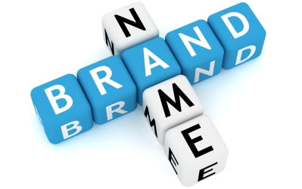
1. Brand Name
It is suggested that you use
“SPARK” as your brand name. This brand name effectively and powerfully communicates your commitment to helping your clients triumph over their challenges by igniting the power within them to change or improve their situation.
The business name is:
Life by Design, LLC

Slide 11
2. Tagline
It is recommended that you use the following tagline as a way to enhance your brand message. The objective is to communicate the idea that everyone has the potential to tap into their inner genius as a resource for greater personal and professional success.
“Ignite Your Inner Genius”

Slide 12
3. Position Statement
It is recommended that you use the position statement listed below:
“As an Executive Life Coach & Speaker, I work with enterprising small business owners to help them step into greater success by reconnect with the SPARK within them that allows them to ignite their inner genius.”

Slide 13
4. Target Market
It is recommended that your focus on the following target market:
“Enterprising Small Business Owners who want to use their gifts and talents at the highest levels possible to create a life and business they love and that works.”

Slide 14
5. Niche
It is recommended that you build your brand under the following niche:
“Helping enterprising small business owners SPARK greater success by igniting their inner genius.”

Slide 15
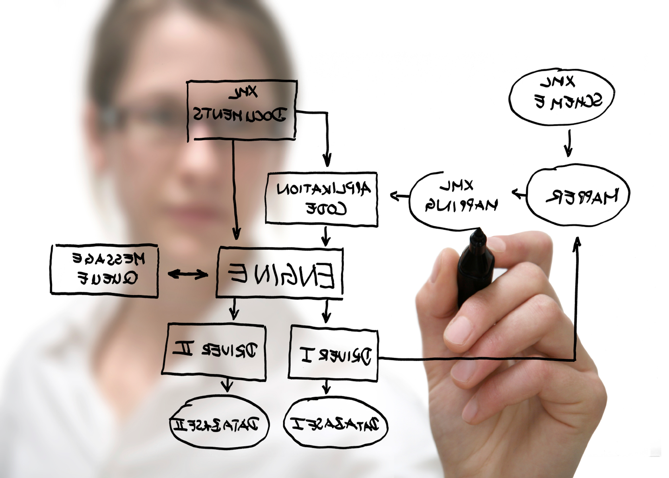
6. Expertise
It is recommended that you use the following label for your expertise:
Igniting Your Inner Genius
Self Awareness & Authenticity
(Know You and Stay True)
Turn Stress in Success
Master Your Mindset

Slide 16
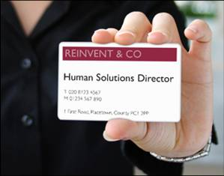
7. Title
It is recommended that you use “Executive Life Coach & Speaker” as your professional work title.

Slide 17
8. Brand Keywords - SEO
Based on our preliminary SEO research, here are your top recommended keywords:
Executive Life Coach
Professional Development
Professional Speaker
Stress Management Speaker
Stress Management Trainer
Avoiding Burnout

Slide 18
8. Brand Keywords – Social Media & Domains
Social Media Accounts (FREE)
Facebook.com – http://Facebook.com/PattyCook
Twitter.com – http://Twitter.com/PattyCook
LinkedIn.com – http://LinkedIn.com/in/PattyCook
YouTube.com – http://YouTube.com/PattyCookVideos
SlideShare.net – http://SlideShare.net/PattyCook
Scribd.com – http://Scribd.com/PattyCook
Pinterest.com – http://pinterest.com/PattyCookPins
Domain to Use for Your Website:
http://PattyCook.com

Slide 19
9. Visual Brand Assets – Brand Colors
The following brand colors are recommended:
Blue, Green and Salmon

Slide 20
10. Ideal Profiles
Ideal Client
Character Profile – This person is enterprising, ready to shift, sees the value in investing in themselves, has crashed and burned, is experiencing a major stressor, recent diagnosis, handling personal issues and would like to triumph over their challenges by igniting their inner genius.
Ideal JV Partner
Character Profile – This person would have a strong following online and at least 1,000 people in their email database. They have a collaborative spirit and have an abundant mentality and not a scarcity mentality. Mutual respect for and interest in each others work.
Ideal Team Member
Character Profile – Someone who provides WOW customer experiences and has proficient technology, social media and business process skills. The person must believe in the vision and mission of Life by Design, LLC.
Ideal Tribe Member
Character Profile – This person consistently shares what they are learning from you with their contacts and they often enroll others into your programs.

Slide 21
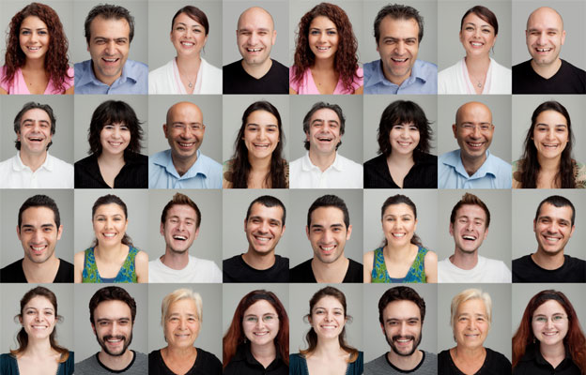
11. Tribe Name
“Fire Starters”
Example as used in the opening of an email you may send out:
“I want to send a special thank you to all of you Fire Starters for your commitment to living a life on fire without burning out.”

Slide 22
12. Movement
“Ignite Your Life”
This movement would encourage people to take one powerful step towards living a life on fire without burning out. This would be the home for the “Fire Starter” community. Participants will be encouraged to support one another and help others reach their goals when they can.

Slide 23
13. Irresistible Free Offer (Pink Spoon)
Values Based Index + 30 minute laser coaching (Value $185), Upsell into to a coaching program, Alternately upsell DiSC + Noah + 45 minute coaching for $147 (Value is $247)
It is recommended that you create a downloadable Value Based Index program that visitors to your site and social networks can use to begin the self discovery process. This document should help them see the “pain/challenges/issues” that are holding them back. They would be encouraged to schedule a follow-up 30 minute laser coaching session with you to process their results. The “pain/challenges/issues” that surfaced during their values based index discovery will be a large part of the follow-up 30 minute laser coaching call.
The 30 minute laser coaching session provides the perfect opportunity for you to upsell them into the $147 DiSC/Noah/45 Minute coaching session.

Slide 24
14. Irresistible Signature Program (ISP)
Recommended signature program(s):
Keynote called “SPARK: Ignite Your Inner Genius”
1-Month Coaching Program called “Jumpstart Your Inner Genius”.
3-Month Coaching Program called “Stoke the SPARK”.
6-Month Coaching Program called “A Life on Fire”.

Slide 25
15. Expert Story
Your Irresistible About Page (400-800 words)
Your Irresistible Bio - Short Form (200-400 words)
Your Essential Marketing Message (75-150 words)

Slide 26
Irresistible About Page (400-800 words)
Executives at Risk of Burnout Can Get Re-Ingited & Achieve Outrageous Success While Improving Their Health & Quality of Life -- Patty Tells Them How...
Patty Cook inspires audiences large and small to remember that they are an unstoppable force with WAY more power over their circumstances than they know.
After 18 years in a highly-successful construction career that she loved, she "crashed and burned." She was overwhelmed, overextended, and didn't feel successful, no matter how hard she worked. She didn’t have a clue how to deal with the stress, so at 37 years old, she just walked way!
Since then, Patty has helped countless professionals at risk of burnout learn to thrive in life and business, teaching them how to achieve their most imaginative goals and withstand life’s greatest challenges to create success from the inside out.
A two-time victor over breast cancer, Patty knows how quickly and radically life can change course, and she is committed to supporting people in living like there’s no tomorrow -- today.
Patty’s message speaks to the heart and mind of employees and executives alike. She delivers a dynamic presentation that entertains and inspires REAL change.

Slide 27
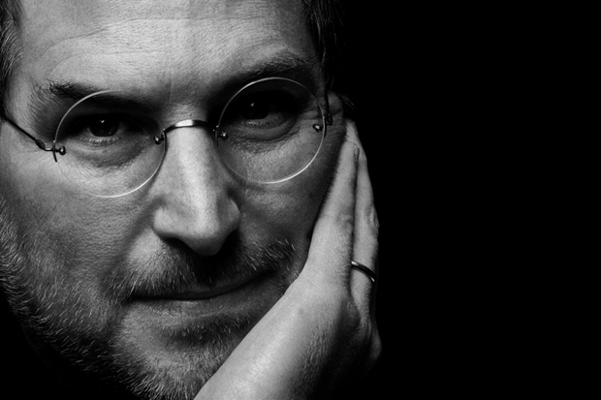
Irresistible Bio Short Form (200-400 words)
Patty Cook inspires audiences large and small to remember that they are an unstoppable force with WAY more power over their circumstances than they know.
After 18 years in a highly-successful construction career that she loved, she "crashed and burned." She was overwhelmed, overextended, and didn't feel successful, no matter how hard she worked. She didn’t have a clue how to deal with the stress, so at 37 years old, she just walked way!
Since then, Patty has helped countless professionals at risk of burnout learn to thrive in life and business, teaching them how to achieve their most imaginative goals and withstand life’s greatest challenges to create success from the inside out.
A two-time victor over breast cancer, Patty knows how quickly and radically life can change course, and she is committed to supporting people in living like there’s no tomorrow -- today.
Patty’s message speaks to the heart and mind of employees and executives alike. She delivers a dynamic presentation that entertains and inspires REAL change.

Slide 28
Essential Marketing Message (75-150 words)
Problem Statement – Articulate the problem or predicament or pain your target market is experiencing in terms that are meaningful to the person you are speaking with.
Problem Story – Tell them more about the problem and discuss examples of those you have worked with.
Expertise – tell them who you are and what your expertise is in.
Target Market – Say who you work with to let them know your services are for them and not someone else.
Solution Statement – Tell them your solution and what makes you different.
Benefits – Tell them how clients benefit when they work with you.

Slide 29
Essential Marketing Message (75-150 words)
“All too often, people find that they get in their way or even hold themselves back from experiencing work and life to its fullest.
I believe that every individual is an unstoppable force with WAY more power over their circumstances than they know. As an Executive Life Coach and Speaker, I work with enterprising small business owners to help them turn their challenges into success by igniting their inner genius.
When clients work with me, they
More time for themselves, with their friends and family.
More energy
Stronger bottom line
get clarity, become more inspired about their future, and they take action to create what they desire.”
Patty Cook

Slide 30
The Perfect Customer Lifecycle

Slide 31
Become a Category of One
Success isn’t about being perceived as the best at what you do,
it’s about being perceived as the only one who does what you do.
- Jerry Garcia of the Grateful Dead

Slide 32
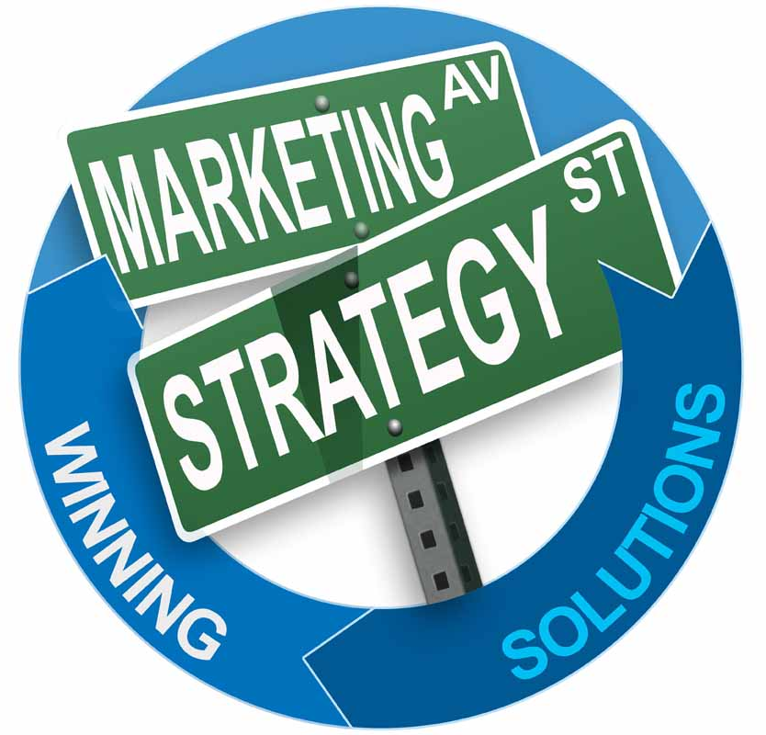
Brand Promotion Recommendations:
Key Promotions and Marketing Activities:
Build the “Fire Starter” Community of tribe members and begin nurturing the relationships with clients, friends, fans, followers and connections using unique language (underlined below) that is specific to your tribe:
Email… “Good morning Fire Starter…”
Facebook… “Today’s Tips to Ignite Your Inner Genius is…[some inspiring message]”
Tweet… “Ignite Your Life is a fun and inspiring journey for enterprising small business owners who are ready to shift to a new level of success. Click here to learn more”
LinkedIn… “Did you know you have the ability to become an unstoppable force today and everyday? Click here to read my latest blog post entitled…”
Website… “Give yourself permission to live a life on fire without burning out.”
Develop a weekly announcement called “Weekly Spark: Live a Life on Fire Without Burning Out”
Engaging, interactive, fun and offers high-value.
Leverages the collaboration cashflow model.
Features a Fire Starter.

Slide 33
Brand Promotion Recommendations: (Continued)
Put on Quarterly Local SPARK Sessions – It is recommended that you develop a series of professional development and women empowerment programs that you can offer to the general public and local organizations.
Create a group coaching community called “Ignite Your Life: Strategies for Living a Life on Fire Without Burning Out”. This would also be the home for the “Fire Starter” community of tribe members. There would be free content added frequently to engage the community and the upsell would be to join the group coaching program to gain access to the paid portion of the site.
Create a series of SPARK Video to submit to online video directories.
Create a series of SPARK Articles to submit to online article directories.
Create a Press Release for each of your signature programs.
Join LinkedIn groups related to your target market and post regular comments and contribute answers to questions within the group.

Slide 34
Other Experts in Patty’s Field
Steve Mitten
http://www.acoach4u.com/
Colbért B. Williams, Sr.
http://www.eandlcinc.com/
Niquenya D. Fulbright
http://www.niquenyafulbright.com/
LB Coaching
http://www.lblifecoaching.com/
Anne Bachrach
http://www.accountabilitycoach.com/

